Slide 1
SDLC and Agile

Slide 2

What is Systems Development?
“The process of taking a set of business requirements through a series of structured stages and translating them into an operational IT system.”
‘Developing Information Systems’
Can we do without SDLC?
Meet expectations.
Code to operational software
Quality
What to do , when, by whom
The cost of software failure
Notes:
Can we do without SDLC? https://www.quora.com/Can-software-be-created-without-SDLC-If-so-how
The needs and the quality expectation of the industry is getting high, and without applying a methodology in your production of software, you can't reach that quality level and validate the requirements. Maybe if you are developing a tiny mobile phone application at home, you can do it without SDLC formally. But even that tiny application development process will follow an Software Development Life Cycle informally consisting of your actions.
When it comes to "Enterprise" applications / projects, without an SDLC, it is like committing suicide. In that case, the risks are too much and you have nothing to mitigate them, no proper requirement management, no testing, some coding, no change management, no proper design, no proper task management ...etc,
Without SDLC, even the project team can not be organized, they wouldn't exactly know what , when , why and which tasks in which order they should do. It would be total mess and the result will be big fail, or very low quality, useless junk.
Today's world require complexity, high standards and high quality, so we need SDLC more then ever.
Systems Development is “The process of taking a set of business requirements through a series of structured stages and translating them into an operational IT system.” From the ‘Developing Information Systems’ book.

Slide 3

Elements of a framework method
Philosophy
Principles
Process
People
Products
Practices
rules
Notes:
It is based on our company philosophy and how we work and manage ourselves and our teams.
We choose principles by which Processes and people work, the products and the quality of work they produce using acceptable practices governed by our principles and those which we have to abide by that are imposed by the rule of law and governing bodies (governance).

Slide 4
Context
Context
S/W Lifecycle
Process
Roles
Deliverables
Techniques
What must be considered before starting?
–
Release plan | Single or multiple
Staff preferred delivery style | Level of skills and expertise
Location of teams and stakeholders | Single site or dispersed
Requirements stability | Audit, quality, regulatory, complexity and stability
Technology to be used | Tried and tested or new?
Notes:
First, the Context needs to be considered before starting.
Release plan – Is the system to be implemented as a single or multiple releases?
Level of skills and expertise – What level of ability and preferred delivery style of the organisation?
Location of teams and stakeholders – Is the team based at a single or dispersed locally, nationally, or globally?
Requirements – What are the audit, quality, regulatory requirements? Complexity and stability of the current operating environment?
Technology– Is the technology (both hardware and software) including servers, databases, packages, programming languages, etc. tried and tested, or new?

Slide 5
Lifecycle
Context
S/W Lifecycle
Process
Roles
Deliverables
Techniques
Describes stages to follow: Plan -> Design -> Build -> Test -> Deliver
Approaches
Linear – Sequential, or step-by-step
Evolutionary – Iterative evolving through versions
Prescriptive – Specific SDLCs
Agnostic – Various SDLCs
Dependent on context and lifecycle chosen
Notes:
A Lifecycle needs to be chosen that describes the framework to use and stages to follow such as: Plan, design, build, test, and deliver.
Basic approaches are:
Linear – Sequential or step by step.
Evolutionary – Iterative evolving through prototypes and progressive versions
Within the chosen Lifecycle, a Process defines the set of steps and actions to follow in order to deliver the outcomes of each stage.
Methods and standards support the framework within the SDLC. This includes defined roles, deliverables, techniques and models. These can vary from very prescriptive to more agnostic approaches dependent on context and lifecycle chosen.

Slide 6
Roles
Project:
Project Manager
Team Leader
Business:
Sponsor or senior business owner
Business Analyst
Domain expert
End users
Technical:
Architect
Developer
Tester
Implementation and Support:
Release Manager
Database Administrators
System Administrators
Context
S/W Lifecycle
Process
Roles
Deliverables
Techniques
People that carry out tasks within various SDLCs
Specific to particular SDLC or generic – Various titles
Include Business, Project, Technical and Support roles
Notes:
Roles define the people that carry out tasks within various SDLCs. They can be specific to a particular SDLC or more generic with various titles including:
Business:
Sponsor or senior business owner
Business Analyst
Domain expert
End users
Project:
Project Manager
Team / Work Package Leader
Technical:
Architect
Developer
Tester
Implementation and Support:
Release Manager
Database Administrators
System Administrators
Release engineers are responsible for assessing the quality and risks of new products. They build test environments and troubleshoot any issues pertaining to the software's performance. They work with software engineers to resolve any issues and document fixes for use in future reference materials. (Google search)

Slide 7
Deliverables
Models:
Class models
ERD, Data models or Logical Data structures
UML Use cases
Process models
State transition diagrams
Sequence diagrams
Component diagrams
System / software
Test plans Deployment plans and scripts
Context
S/W Lifecycle
Process
Roles
Deliverables
Techniques
Notes:
Deliverables are the documents, models, designs, hardware and software required as outputs for for different SDLCs and stages. They detail the understanding of requirements and answer the questions of what, how, quality, when?
Examples include:
Requirement documents
Models:
Class models
Entity Relationship diagrams or Data models or Logical Data structures
Use cases
Process models
State transition diagrams
Sequence diagrams
Component diagrams
System / software components
Test / implementation plans and scripts
Examples of models include:

Slide 8
System Development Life Cycle (SDLC)
Is a framework describing a process to…
Understand
Plan
Build
Test
Deploy
Can apply to
Hardware
Software
Both
Feasibility Study
Requirements Analysis
Design
Code Development
Testing
Deployment / Implementation
Maintenance
Notes:
In any SDLC there are several stages that must be undertaken. These are shown as sequential steps although they do not have to be as we consider different lifecycles.
The main stages vary dependent on the systems development approach being used but typically include:
Feasibility Study Why do we need the system?
Requirements Analysis What does the system need to do?
Design How will the system and components be built?
Code Development Construct system to meet requirements
Testing Checks that system does what it should do and how it should do it
Deployment / Implementation Deploys the system in the live, or production, or operational environment
Maintenance Support the live system

Slide 9
Requirement Analysis
Gain understanding of what the business needs the proposed system to do Business Analysts elicit, analyse, document, and validate requirements
Decide how to store, manage, access, and update requirements
Also known as Requirements Engineering (RE)
Make use of tools such as UML
Feasibility Study
Requirements Analysis
Design
Code Development
Testing
Deployment / Implementation
What make a good requirement?
And why is it important?
Maintenance
Notes:
The next stage is Requirements Analysis, in which an understanding of what the business needs the proposed system to do is captured.
Business Analysts elicit, analyse, document, and validate requirements from the sponsors, business, users, and customers as appropriate.
A method and process is needed to store, manage, access, and update the requirements. This is a key input to design as the requirements are traced through SDLC. The level of detail required is influenced by the SDLC used.
This stage is also known as Requirements Engineering.

Slide 10
Design
Evaluate solutions that meet requirements.
Develop the chosen design with detail to begin development
Make use of tools such as UML
Feasibility Study
Requirements Analysis
Design
Code Development
Testing
Deployment / Implementation
Maintenance
Notes:
The Design stage evaluates possible solutions that meet the requirements. The chosen design is elaborated upon to sufficient detail to enable development to start.

Slide 11
Code Development (Programming or Build)
Hardware and software technical components created, procured or configured
Follow design to ensure system does what is required
Make use of tools such as
automated build tools
code coverage
testing frameworks
Feasibility Study
Requirements Analysis
Design
Code Development
Testing
Deployment / Implementation
Maintenance
Notes:
Development is when the hardware and software technical components are created, procured, or configured. The design is followed to ensure the system does what is required.
This stage is also known as Programming or Build.

Slide 12
Testing
Components produced tested to ensure working properly and does what supposed to do
Different levels of testing
Unit
Integration
System
User Acceptance
Make use of tools such as automated build tools and code coverage and testing frameworks
Feasibility Study
Requirements Analysis
Design
Code Development
Testing
Deployment / Implementation
Maintenance
Notes:
The next stage is Testing when the components produced during Development are tested to ensure they are working properly and do what they are supposed to do. There are several different levels and types of testing including:
Unit – Check individual components meet their requirements.
Integration – Ensure the checked components communicate and interface correctly.
System – Test the completed system performs the required end-to-end functionality.
User Acceptance – The user or customer tests the system from a business perspective.

Slide 13
Deployment / Implementation
Commission the system in ‘live’ environment
Known as operation or production environment
Developed in ‘test’ environment
Must be carefully planned, understood and managed
Make use of tools such as
automated build tools
code coverage
testing frameworks
Feasibility Study
Requirements Analysis
Design
Code Development
Testing
Deployment / Implementation
Maintenance
Notes:
The penultimate stage is Implementation. The completed system needs to be commissioned or deployed in the ‘live’ environment, also known as the operation or production environment.
The systems is developed in a ‘test’ environment to protect the ‘live’ systems. This needs to be carefully planned, understood, and managed to minimise any possible disruption to the business.

Slide 14
Maintenance
Feasibility Study
More than bug fixing or keeping the system in good order
20% Corrective
80% Enhancements
Requirements Analysis
Design
Depends on
Development strategy (one release or incremental)
Lifetime of operation
Code Development
Testing
Maintenance Types
Corrective
Adaptive
Perfective
Preventative
Fixing technical or requirement-based faults.
Making changes to meet new or updated requirements.
Improve non-functional requirements
Addressing foreseeable or hidden errors.
Deployment / Implementation
Maintenance
Notes:
The final stage is Maintenance. This is much more than just correcting faults or keeping the system in good running order. Evidence suggests only 20% of maintenance work is actually corrective with the remaining 80% being related to system enhancements. This is dependent on the development strategy. Is the system all delivered in one release or does it evolve over several increments? Also the planned lifetime of operation. Is the system only expected to last for short timespan or several years?
Maintenance can be categorised as:
Corrective – Fixing faults and failures discovered within the system whether technical or interpretation of requirements.
Adaptive – Making changes or enhancements to the system to meet new or changed requirements.
Perfective - Tuning the system to make it work better often focused on non-functional requirements
Preventative – Action taken on foreseeable or latent errors.

Slide 15
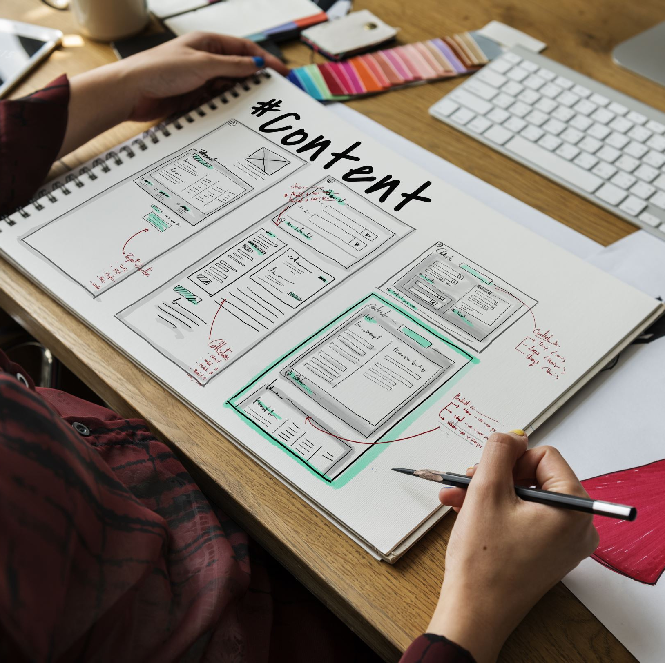
What is agile?

Slide 16
Understand What Agile is
Why you would want to use Agile for your Software Development Project
Appreciate the concept of the Agile Manifesto
Understand and use the 12 Agile Principles to support the Agile Manifesto and the Agile Framework.
Objectives
Of this session

Slide 17
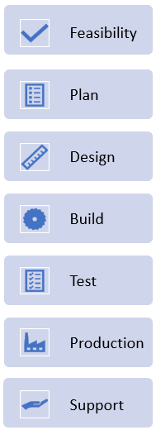
Tons of documentation up front
Business requirements, Application’s architecture
Data structures, Functional designs
User interfaces, non-functional requirements
No code before all design are complete
Then Tests and eventually deploy
Large teams needed, even for a small project
But it worked!
Systems were large, monolithic, clear outcome
Requirements changed slowly
We now require speed, flexibility in a changing world
Before Agile
Waterfall

Slide 18

Why Agile?
The dynamic and fast-moving nature of the world today:
Volatility
Uncertainty
Complexity
Ambiguity
In this environment, the assumption that a solution can be designed in detail up-front does not reflect reality.

Slide 19
Agile is the most common software development methodology
It is an evolutionary methodology
The software solution is developed through early prototype or iteration releases
What is Agile
Iterative releases

Slide 20










Evolutionary and waterfall comparison
Not what I wanted!

Slide 21
What is important in Agile?
Values
Principles
Practices
Rules
Notes:
Important point!

Slide 22
Why USE Agile?
Requirements not well understood
Iterations uncover understanding
Demo working software to gather feedback
Early delivery more important than completeness
Early benefits – Justify funding £
Quick to market – High value features first
High business/technical risk.
Difficult to define and express what is needed

Slide 23

Launched in 2001
17 technologists drafted the Agile Manifesto
Devised 4 principles for agile software production
Agile
Notes:
Kent Beck
Mike Beedle
Arie van Bennekum
Alistair Cockburn
Ward Cunningham
Martin Fowler
James Grenning
Jim Highsmith
Andrew Hunt
Ron Jeffries
Jon Kern
Brian Marick
Robert C. Martin (Uncle Bob)
Steve Mellor
Ken Schwaber
Jeff Sutherland
Dave Thomas

Slide 24
A framework is Agile if it follows the Agile Manifesto.
Individuals and interactions over processes and tools
Working software over comprehensive documentation
Customer collaboration over contract negotiation
Responding to change over following a plan
The Agile manifesto
Notes:
The manifesto was developed in 2001 by 17 leading IT professionals who felt that IT development was failing to meet the growing challenges faced by business. This led to a whole new way of thinking about software development. Linear lifecycles fell out of favour and more evolutionary approaches like Scrum became more popular.
The four values summarised the key points of their combined experience of developing software and helping others develop software. Explanations of each value are:
Individuals and interactions - Self-organization and motivation of individuals and their interactions through co-location and pair programming are more important that a reliance on tools and processes.
Working software - Actual software that works is more useful than documents about what the software will or can do.
Customer collaboration – It is difficult, if not impossible, to specify the requirements fully at the start of the project, therefore continuous customer and stakeholder involvement throughout the project is key rather that defining and agreeing a contract.
Responding to change - Agile development focuses on quick responses to change and continuous development instead of just sticking to the original plan.

Slide 25
We follow these principles:
Our highest priority is to satisfy the customer through early and continuous delivery of valuable software
Welcome changing requirements, even late in development. Agile processes harness change for the customer's competitive advantage
Deliver working software frequently, from a couple of weeks to a couple of months, with a preference to the shorter timescale
Business people and developers must work together daily throughout the project
Build projects around motivated individuals. Give them the environment and support they need, and trust them to get the job done
The most efficient and effective method of conveying information to and within a development team is face-to-face conversation
1
Agile principles 1-6
2
3
4
5
6
Notes:
The Agile Principles are a set of 12 guiding concepts to support project teams when implementing agile projects. The principles should be used to implement agile methodologies in projects. The first six principles are:
Our highest priority is to satisfy the customer through early and continuous delivery of valuable software.
Welcome changing requirements, even late in development. Agile processes harness change for the customer's competitive advantage.
Deliver working software frequently, from a couple of weeks to a couple of months, with a preference to the shorter timescale.
Business people and developers must work together daily throughout the project.
Build projects around motivated individuals. Give them the environment and support they need, and trust them to get the job done.
The most efficient and effective method of conveying information to and within a development team is face-to-face conversation.

Slide 26
Agile principles 7 - 12
7
Working software is the primary measure of progress
Agile processes promote sustainable development. The sponsors, developers, and users should be able to maintain a constant pace indefinitely
Continuous attention to technical excellence and good design enhances agility
Simplicity – the art of maximising the amount of work not done – is essential
The best architectures, requirements, and designs emerge from self-organising teams
At regular intervals, the team reflects on how to become more effective, then tunes and adjusts its behaviour accordingly
8
9
10
11
12
12
Notes:
The second six principles are:
Working software is the primary measure of progress.
Agile processes promote sustainable development. The sponsors, developers, and users should be able to maintain a constant pace indefinitely.
Continuous attention to technical excellence and good design enhances agility.
Simplicity--the art of maximizing the amount of work not done--is essential.
The best architectures, requirements, and designs emerge from self-organizing teams.
At regular intervals, the team reflects on how to become more effective, then tunes and adjusts its behaviour accordingly.

Slide 27
What Agile is about?
Discussion over documentation
Small steps done often
Encourages change
People act autonomously
No silo mentality
Welcome reviews
Encourage teamwork
Trust people to do their job
Communicate best practices
Fail fast and adjust quickly!
Regular demonstration of results

Slide 28

The Scrum framework gets its name from Rugby In Rugby, the individual players work as a single unit to move.
Is repetitive and will produce a runnable result at the end of every sprint which is ‘shippable’; not half-broken
The code will add functionality to what was there previously, therefore adding value.
AGILE SCRUM

Slide 29
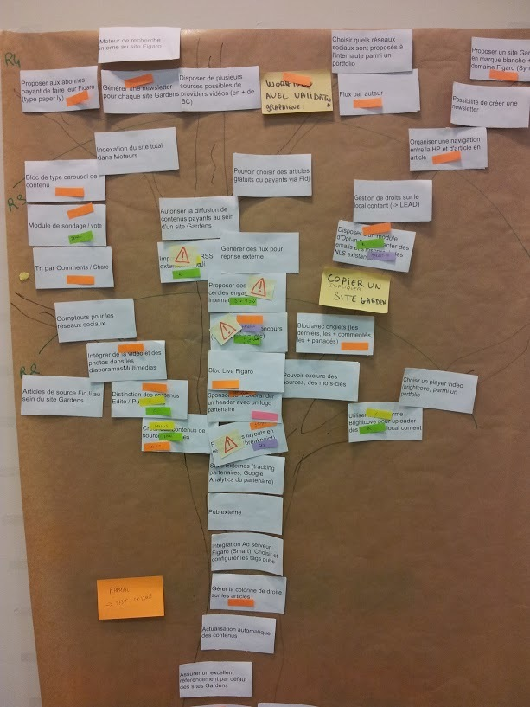
Is the list of all features, enhancements and fixes to be made to the product in future releases.
Include a description, order, estimate, and value.
The product owner is responsible for the product backlog, its content, availability, and ordering.
The dev team collaborates with the product owner, adding details to the backlog items where necessary
PRODUCT BACKLOG
This Photo by Unknown Author is licensed under CC BY-SA

Slide 30



Defines what a PBI needs before it can go into the sprint backlog.
A checklist of items could include:
Definition of ready (DOR)
Technical details discussed & agreed
Priority assigned
Acceptance Criteria defined

Slide 31
Product Backlog Item (PBI)
Must have a clear description. A clear user story
Offer a Business value properly articulated and agreed
Acceptance criteria is clear and testable
Must have the staff to do it
dependencies on other systems/things are identified.
The Product Owner has approved it

Slide 32
Definition of done (DoD) defines what is needed before it can be regarded as complete. Can be applied to a feature, a Sprint or a release.
A checklist of items which could be included for a feature could include:
Definition of done (DOD)
Unit testing written and passed
Documentation updated
Peer code review completed

Slide 33
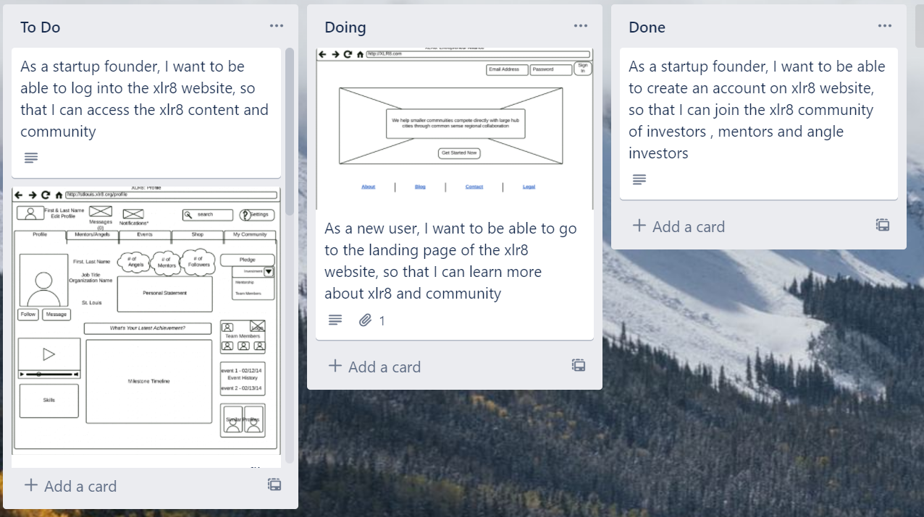
A sprint backlog is usually presented in a Kanban board.
As tasks are worked, the cards move from one end of the board to the other. This movement helps the team to see the project’s progress.
Trello is a common project tracking tool.
Sprint backlog

Slide 34
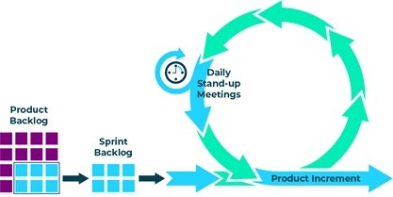
A sprint is a time-boxed event
The aim is to produce new production-ready code
A sprint can be between 1 to 4 weeks long
Sprints will run one after another until the product no longer needs development.
What is a sprint?
Sprint 1
1
Sprint 2
2
Sprint 3
Notes:
The scrum team along with the Product owner, have a meeting where they decide which items from the product backlog will be included in the next sprint.
This items are moved to the sprint backlog. The scrum team then work on the items until a product item is complete and will be able to be included in the next product increment. Each day first thing in the morning a Daily Stand-up meeting is held.

Slide 35

Roles which people take in an Agile Project
Roles
Stakeholder
Project manager
Product Owner
Business Analyst
Scrum Master
Development Team

Slide 36
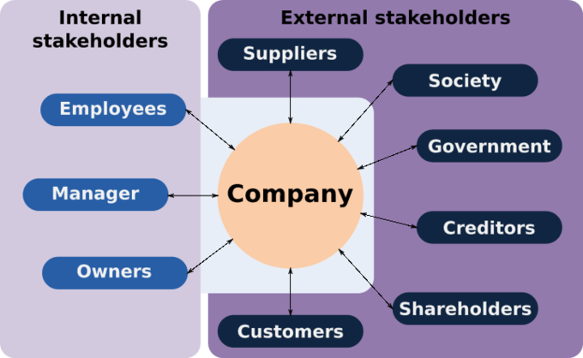
A stakeholder is anyone with an interest in or an influence on the product.
Should be contactable by the development team to help them to understand what is required.
They should attend the Sprint review meeting
The stakeholder
Notes:
This Photo by Unknown Author is licensed under CC BY-SA

Slide 37
Is the sole person responsible for managing the product backlog (list of features to be worked on).
They communicate with the stakeholders to ensure requires are added to the product backlog
They attend the Sprint planning meeting and Sprint review meeting
Product Owner

Slide 38

Manages projects and will overview expenses.
Try to reduce risk on the project.
May manage more than one project
Project Manager

Slide 39

Supports the product owner by gathering requirements and providing guidance on what to build.
They usually work across many products.
Business Analyst (BA)
Notes:
This Photo by Unknown Author is licensed under CC BY

Slide 40

Helps those outside the scrum team understand which interactions are beneficial.
Scrum master
Help find techniques with effective Product Goal definition and Product Backlog management
Supports the development team by removing impediments, facilitating meetings and coaching self-organisation
Attends the Sprint planning, Daily stand up, Sprint review
and the Sprint Retrospective meetings

Slide 41

A multi-disciplinary development team usually consists of software architects, designers, programmers and testers.
This is a self-organising team. They decide how to tackle the items in the sprint backlog.
People with other skillsets can be added to the team
Attend the Sprint planning, Daily stand up, Sprint review and the Sprint Retrospective meetings
DEVELOPMENT TEAM

Slide 42
Sprint planning meeting
Held at the beginning of the sprint.
May take a day for a two-week sprint and is split into two sections (what and how).
Team decide what is going to be brought into the sprint backlog.
Team decide how the items are going to be completed,
Done by breaking down the tasks into smaller pieces and adding technical details.

Slide 43

Is a daily 15-minute meeting used to optimise communication across the team.
Following points are discussed by every participant:
What did I do yesterday that helped meet the sprint goal?
What will I do today to help meet the sprint goal?
Do I see any future impediments that prevents the team from meeting the sprint goal?
Daily Stand up
Notes:
Each participant stands up when it is their turn to speak. This communication keeps the whole team up to date on progress. It also allows them to look at future impediments which need to be addressed to allow the team to meet their goals.
It is the responsibility of the Scrum Master to facilitate the removal of the impediments.

Slide 44
Held at the end of the sprint to inspect the work done and adapt the product backlog.
The dev team demonstrates what work was done, and answers any questions
The product owner discusses the product backlog as it stands
The entire group collaborates on what to do next, to provide valuable input to future sprint planning
Sprint Review
Meeting
The dev team, product owner and key stakeholders attend this meeting.

Slide 45
Is an opportunity for the scrum team to inspect itself and create a plan for improvements to be made during the next sprint.
Identify what went well and any potential improvements that could be made
Create a plan for implementing improvements to the way the scrum team works
Inspect how the last sprint went with regards to people, relationships, process, and tools
The goal is to:
Sprint retrospective meeting

Slide 46
User Stories
Let’s examine the role of User Stories in an Agile Project
User story format
Acceptance Criteria

Slide 47
Is a simple description of a product feature that is written from an end user’s viewpoint
User stories consist of 3 parts
Who is the user / customer
What do they want to do
Why do they want to do it (value to the user)
User story

Slide 48
As a (user), I want (goal) so that I can (value or why)
The user story is:-
Independent of other user stories
Feasible. Can change and adapt to the users’ needs
Valuable. It has concrete value to the user
Estimable how complex is it
Small enough for a team member to finish in time
Testable
Writing user stories

Slide 49
User Story 1 – Create an account for a new user
As a subscriber
I want to be able to create an account on my technical website
So that I can learn the best technical indicators to help me improve my trading.
This user story requires further criteria so that a developer can start work
example

Slide 50
Acceptance criteria dictates the conditions for software to be considered done.
It is a set of statements that usually have a pass / fail result for all requirements.
Acceptance Criteria
Attached to user stories to understand what a feature needs.
Defines the minimum viable product. Can also derive tests from the criteria.

Slide 51
User Story 1 - Create an account for a new user
As a subscriber
I want to be able to create an account on MyTechnicals website
So that I can learn the best technical indicators to help me improve my trading.
Acceptance Criteria
1. Able to create an account manually (filling out the sign-up form)
2. Able to create an account via Facebook
3. Able to create an account via Google
4. Able to create an account via LinkedIn
The user story is now DoR
Example

Slide 52
Time estimation - Story Points NOT Time
Traditionally when prioritising and scheduling tasks, analysts would use Complexity and Time as key factors
This has proven to be a unsatisfactory way of prioritising and scheduling workloads
Recommended approach – story points
A value assigned that represents its complexity and time to deliver

Slide 53
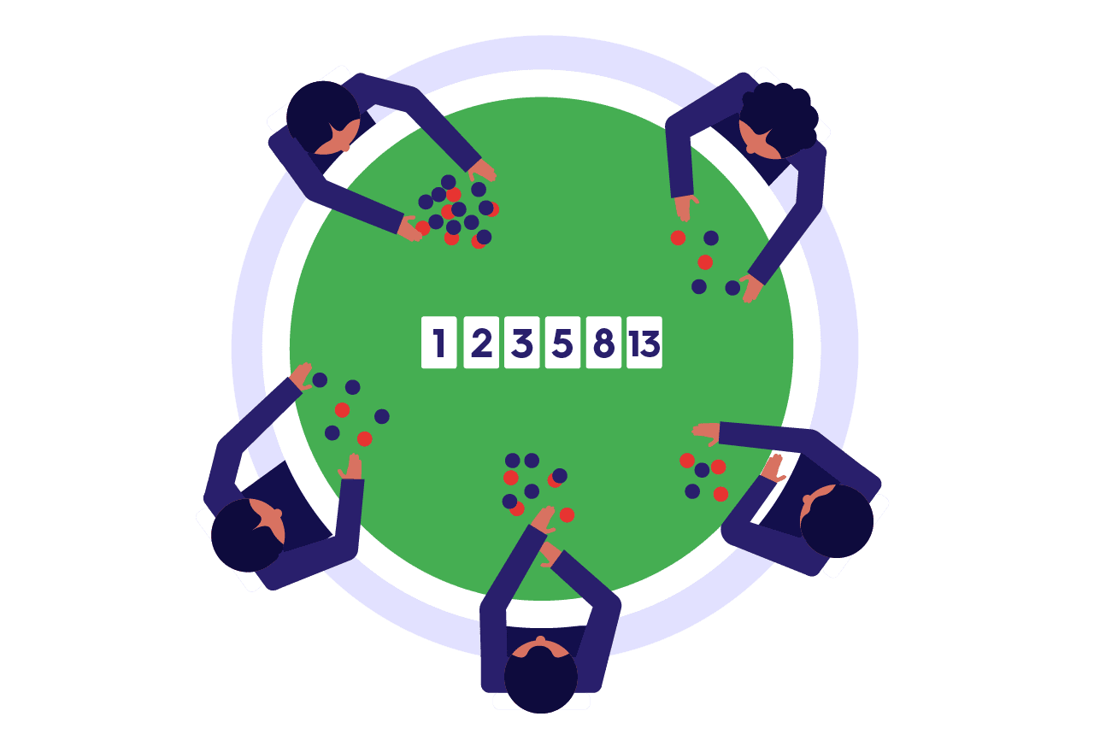
Estimation
Techniques for assigning story points
Estimation Poker - https://www.planningpoker.com/
https://agilescrumgroup.nl/scrum-planning-poker-swimlane-sizing/

Slide 54
Summary
What Agile Scrum is
What the product backlog
Definition of Ready (DoR)
What is the sprint backlog
Definition of Done (DoD)

